Slide 1
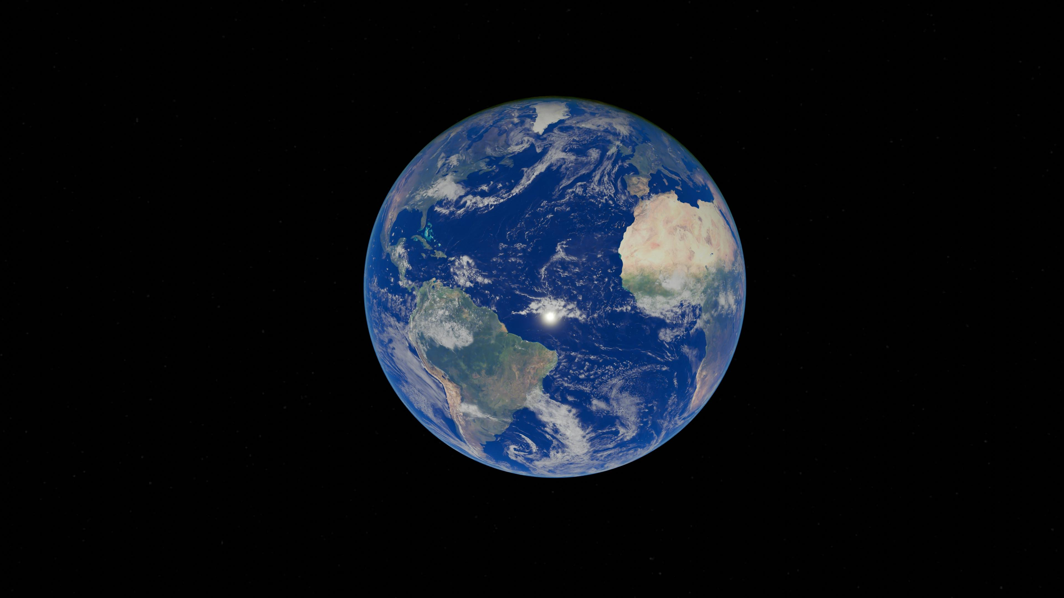

GreenRock

Slide 2
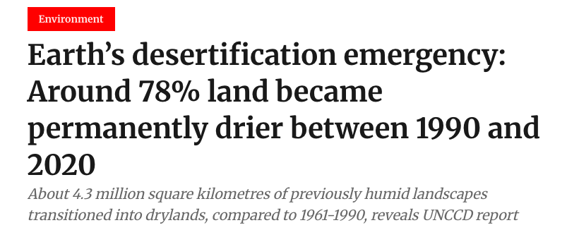

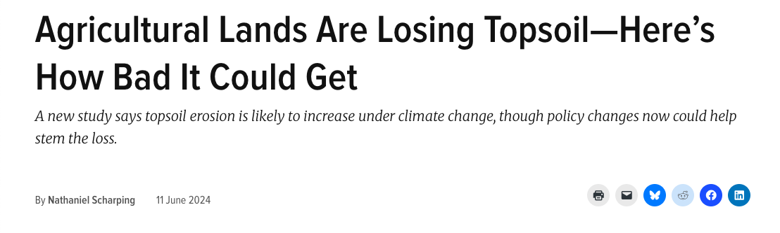

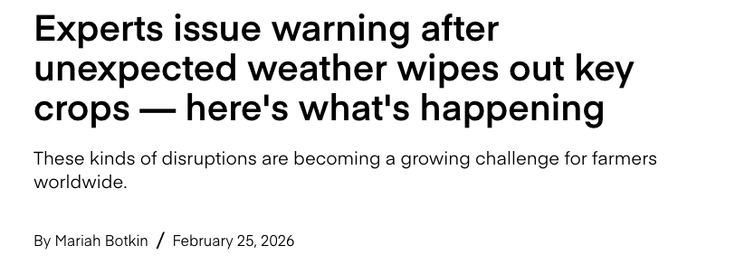
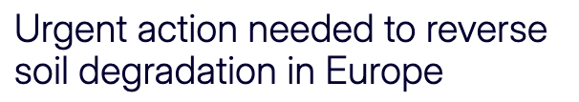



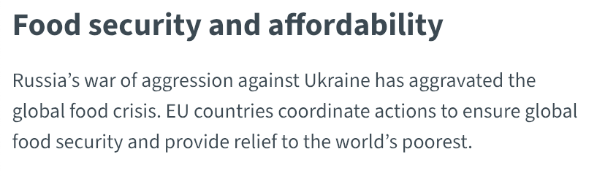

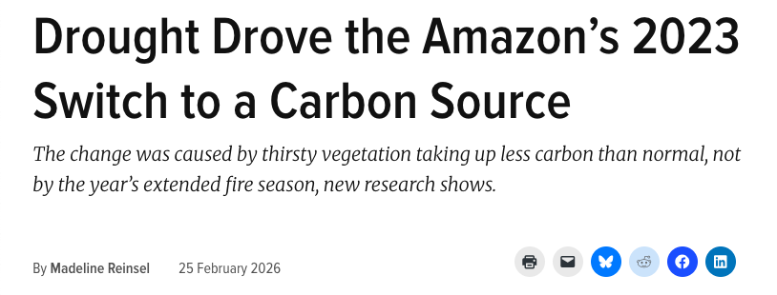
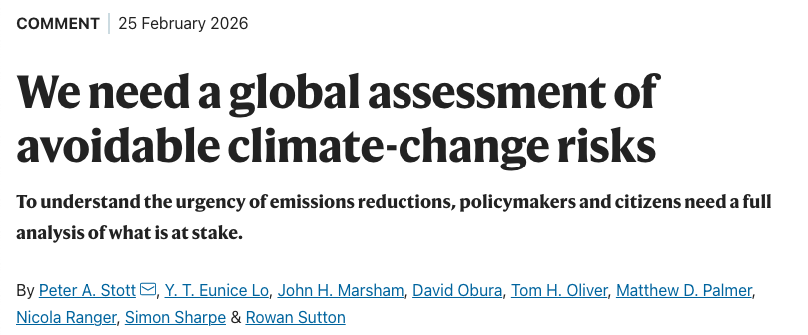


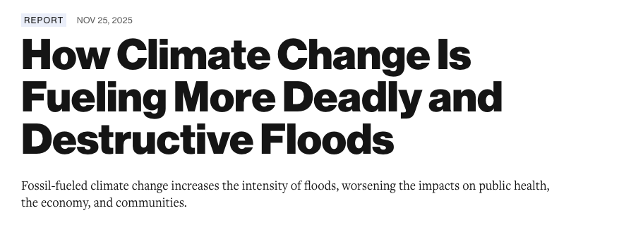
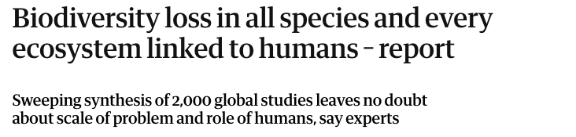

Urgent Global Topics
- Topsoil Erosion
- Floods
- Soil Degradation
- Water Insecurity
- Desertification
- Droughts
- Wildfires
- Biodiversity Loss
- Crop Loss
- Food Insecurity
- Climate Change
- Political Unrest

Slide 3
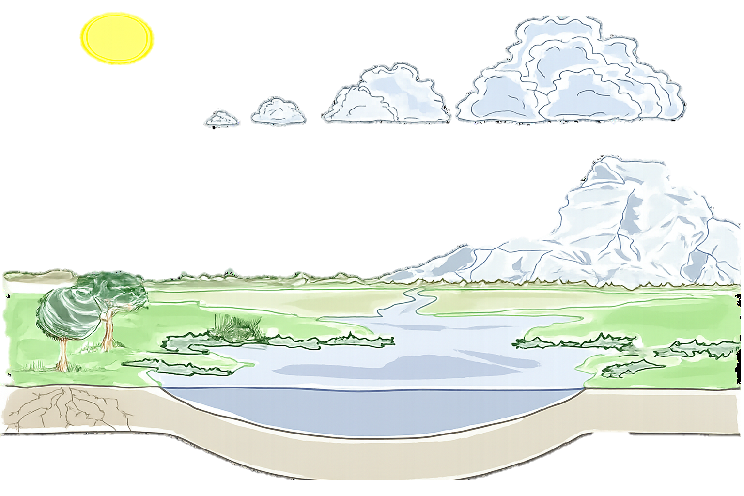
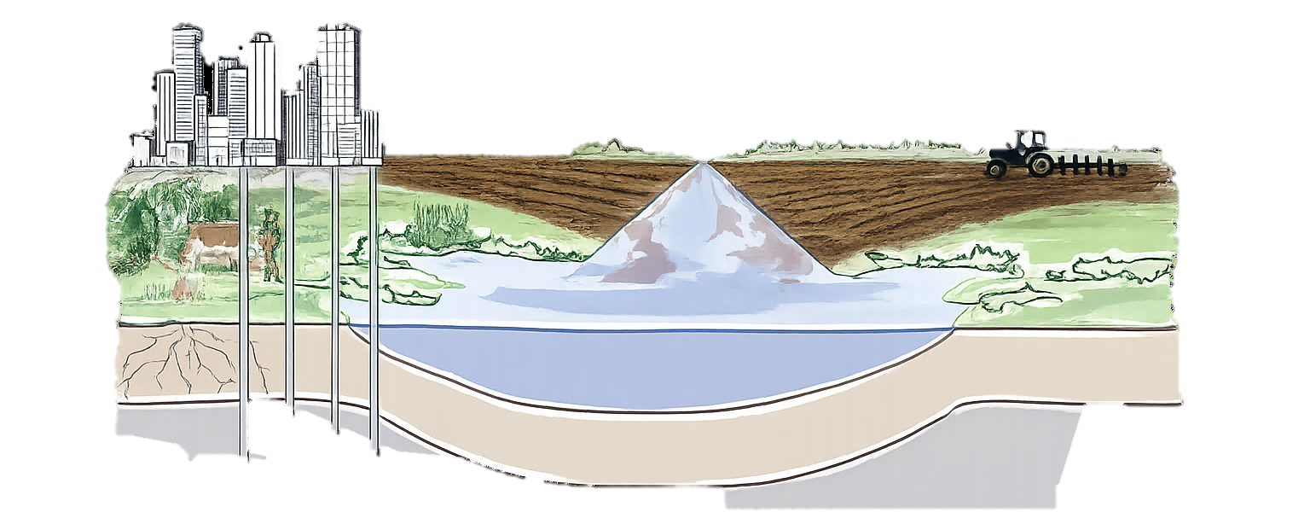
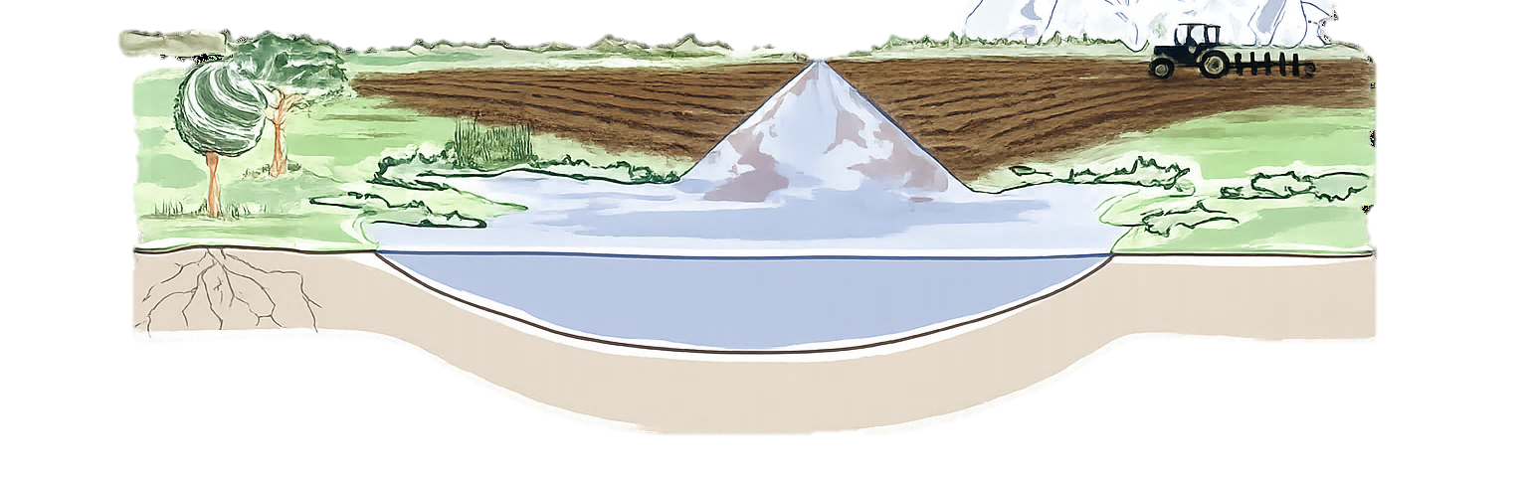
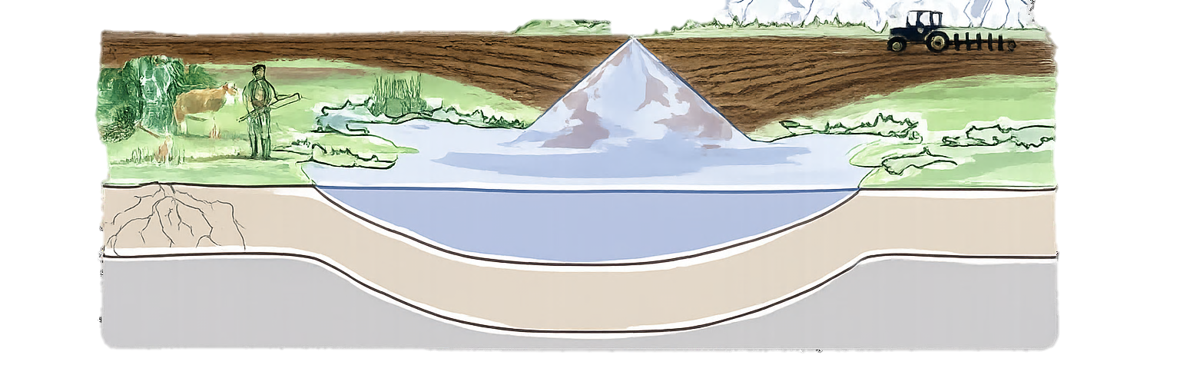
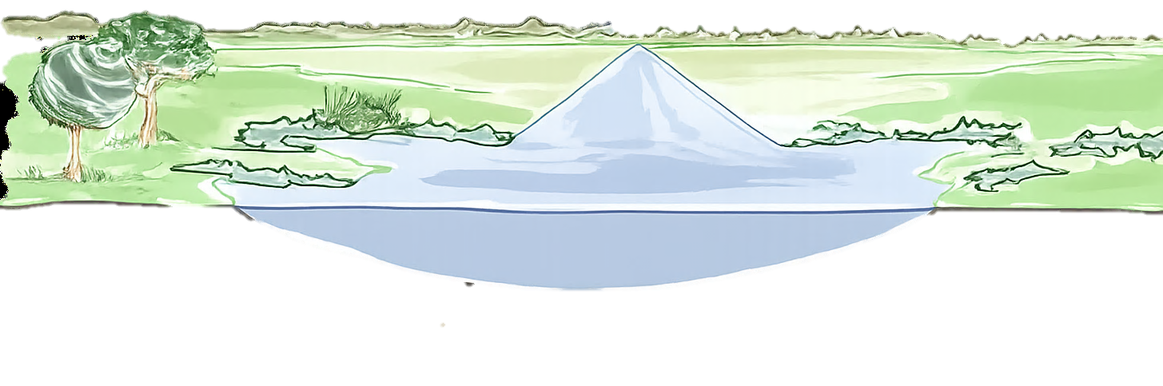

Key Mechanism:
A Working Water Cycle
Current Reality:
A Broken Water Cycle
Transport
Precipitation
Evapotranspiration
(Snowmelt) Runoff
Evaporation
Surface Runoff
Infiltration into Groundwater
Our Solution
Plant Uptake
Groundwater Flow

Slide 4
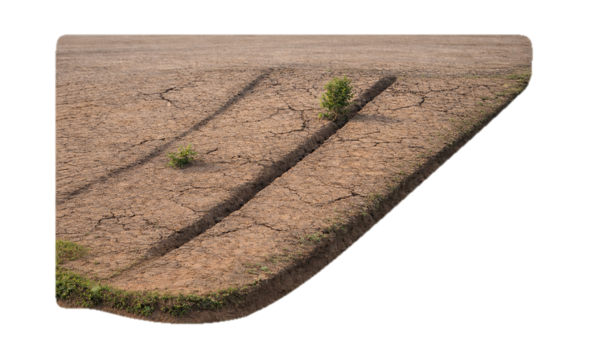
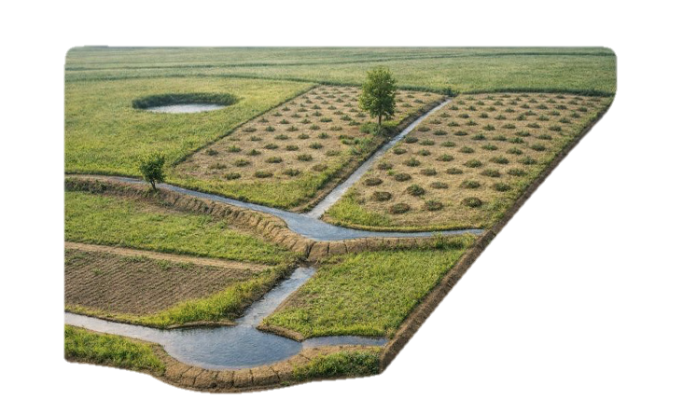
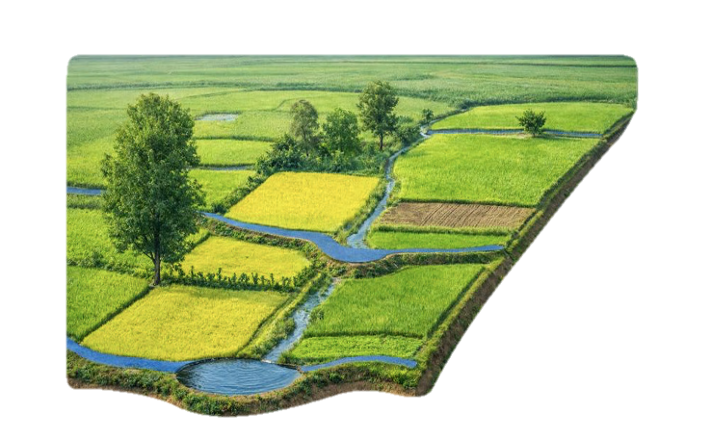
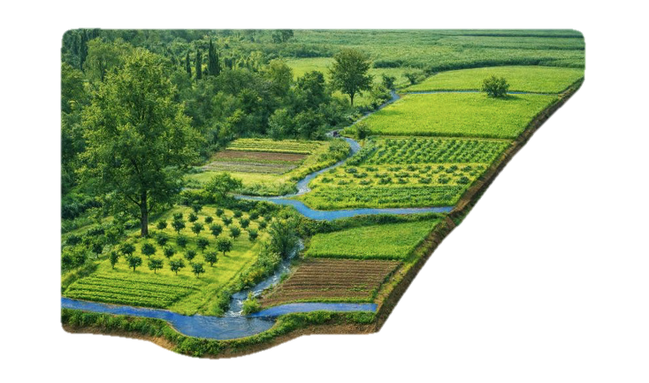
Year 0 1 2 3 4 5 & Beyond
Natural Water Retention Measure (NWRM) Landscapes
Topics Addressed
- Topsoil Erosion
- Floods
- Soil Degradation
- Water Insecurity
- Desertification
- Droughts - Wildfires
- Biodiversity Loss
- Crop Loss
- Food Insecurity
- Climate Change
- Political Unrest
4 Phases
100 ha Example

Slide 5
Year 0
Phase 1: Acquisition & Analysis
Acquire 100 ha Degraded Agricultural Land
Topics Addressed
Gather LiDAR Geo-Spatial Data for NWRM Implementation
- Topsoil Erosion
- Floods
- Soil Degradation
- Water Insecurity
- Desertification
- Droughts
- Wildfires
- Biodiversity Loss
- Crop Loss
- Food Insecurity
- Climate Change
- Political Unrest
Gather Soil Samples & Biodiversity Surveys
Extensive Natural & Geo-Spatial Database
Costs €580.000
Gains € 3.500
Asset €500.000
Notes:
Biodiversity survey based on Bachelor Thesis Interns remunerated €500/month

Slide 6
Year 0 1
Phase 2: Implementation
Design Water Retention Landscape
Topics Addressed
Implement NWRMs
- Topsoil Erosion
- Floods
- Soil Degradation
- Water Insecurity
- Desertification
- Droughts
- Wildfires
- Biodiversity Loss
- Crop Loss
- Food Insecurity
- Climate Change
- Political Unrest
Ponds
Micro-Catchments
Swales
Dams
Keyline Design
Direct Environmental Benefits
Costs € 150.000
Gains € 110.000
Asset €510.000

Slide 7
Year 1 5
Phase 3: Monitoring & Maintenance
Monitor Soil Health & Biodiversity
LiDAR Snapshot
Topics Addressed
- Topsoil Erosion
- Floods
- Soil Degradation
- Water Insecurity
- Desertification
- Droughts
- Wildfires
- Biodiversity Loss
- Crop Loss
- Food Insecurity
- Climate Change
- Political Unrest
Maintain NWRMs
Give Nature Time To Regenerate Itself
Create a Tested Blueprint for Regeneration
Costs €330.000
Gains € 82.500
Asset €620.000

Slide 8
Year 5 & Beyond
Phase 4: Reintegration
Determine Future Use with Local Community
Topics Addressed
Implement Agro-Ecological Practices
- Topsoil Erosion
- Floods
- Soil Degradation
- Water Insecurity
- Desertification
- Droughts
- Wildfires
- Biodiversity Loss
- Crop Loss
- Food Insecurity
- Climate Change
- Political Unrest
Introducing the Regenerative Episteme: New Way-of-Being with Nature
Costs € TBD
Gains € TBD
Asset €700.000

Slide 9
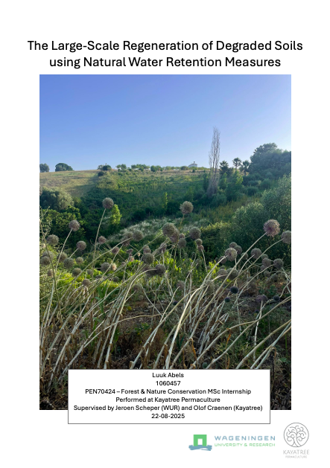
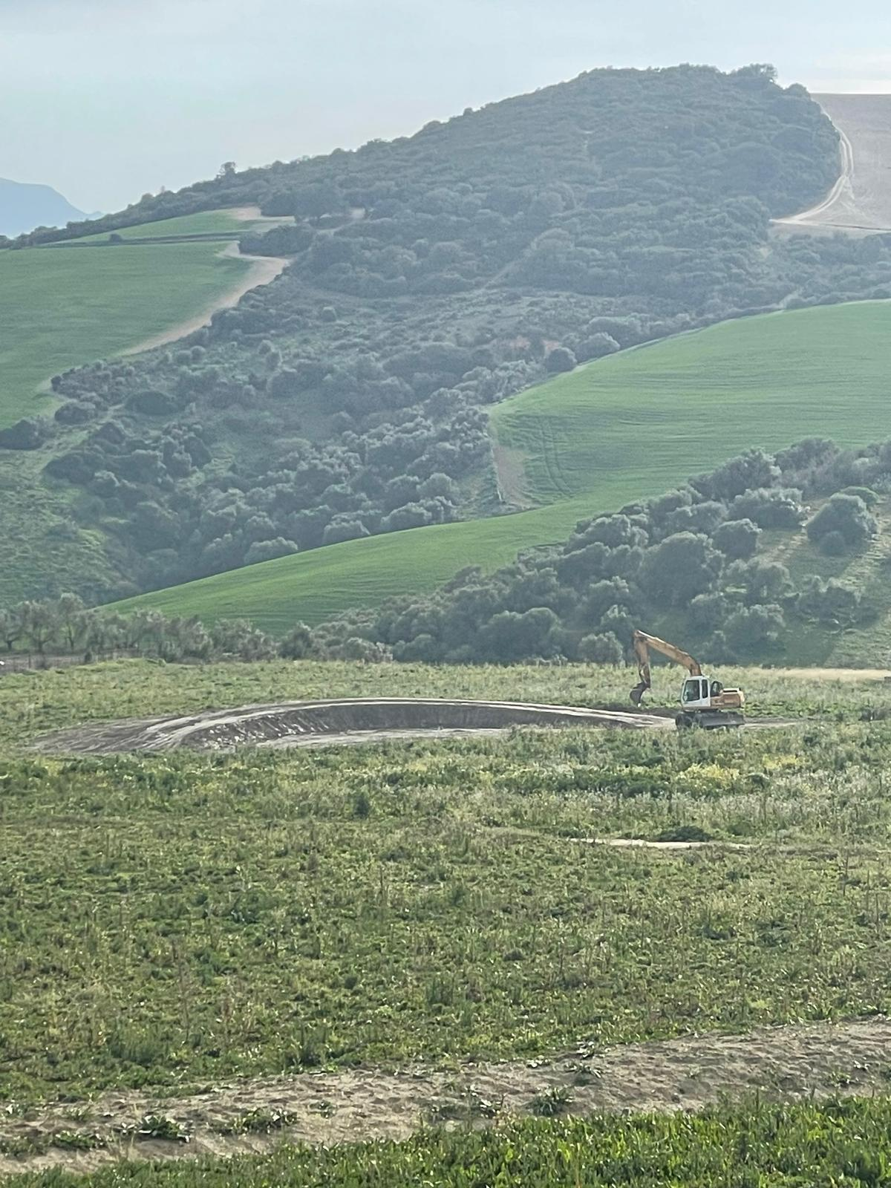
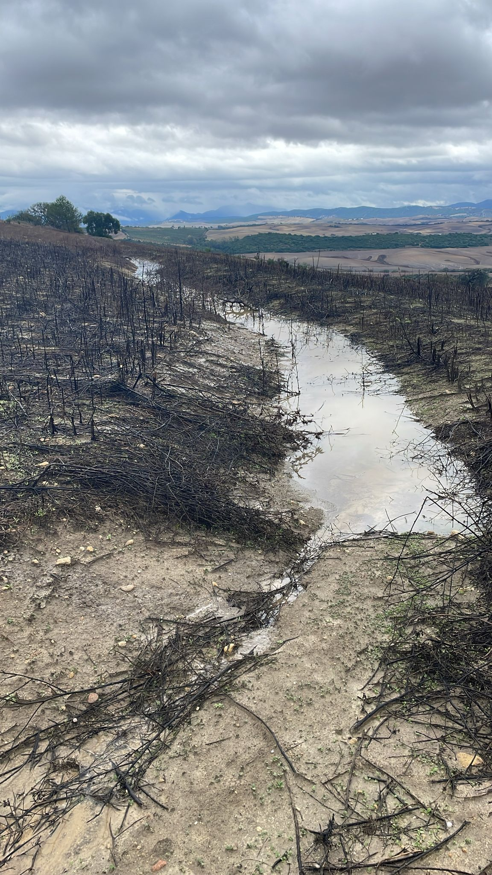
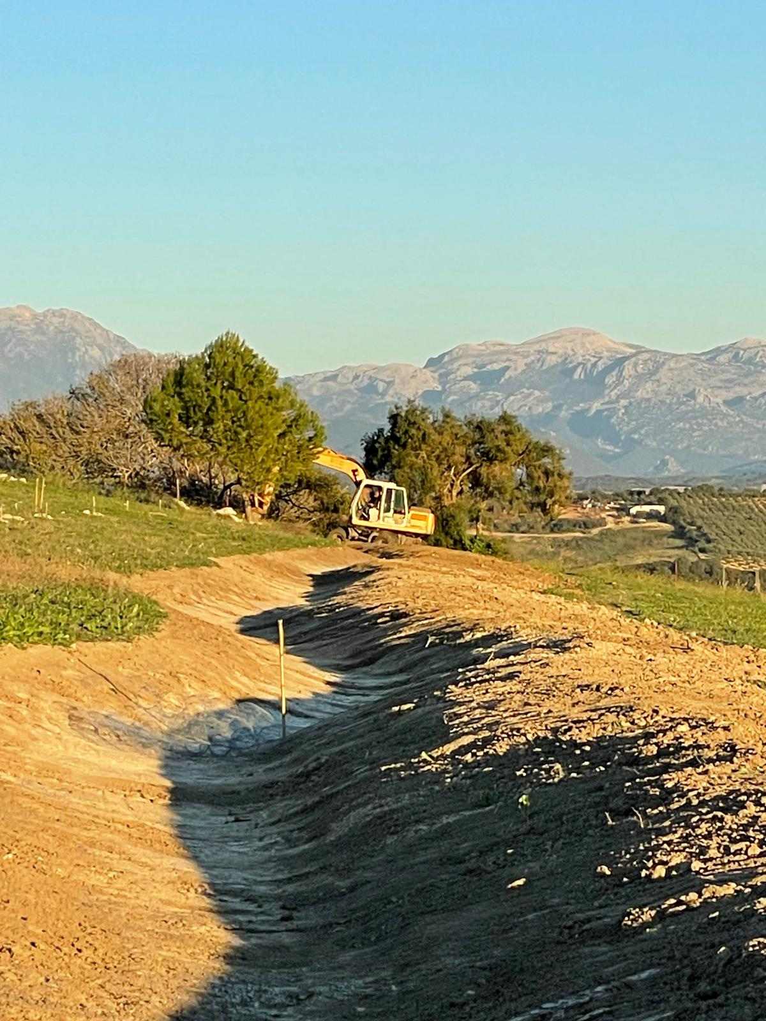
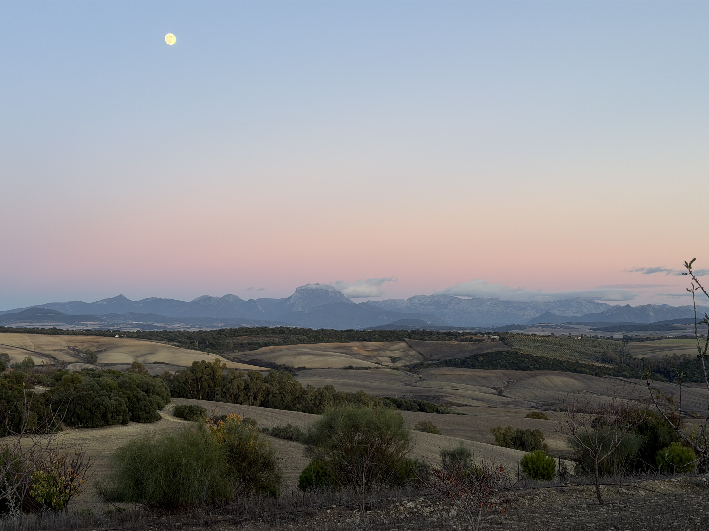
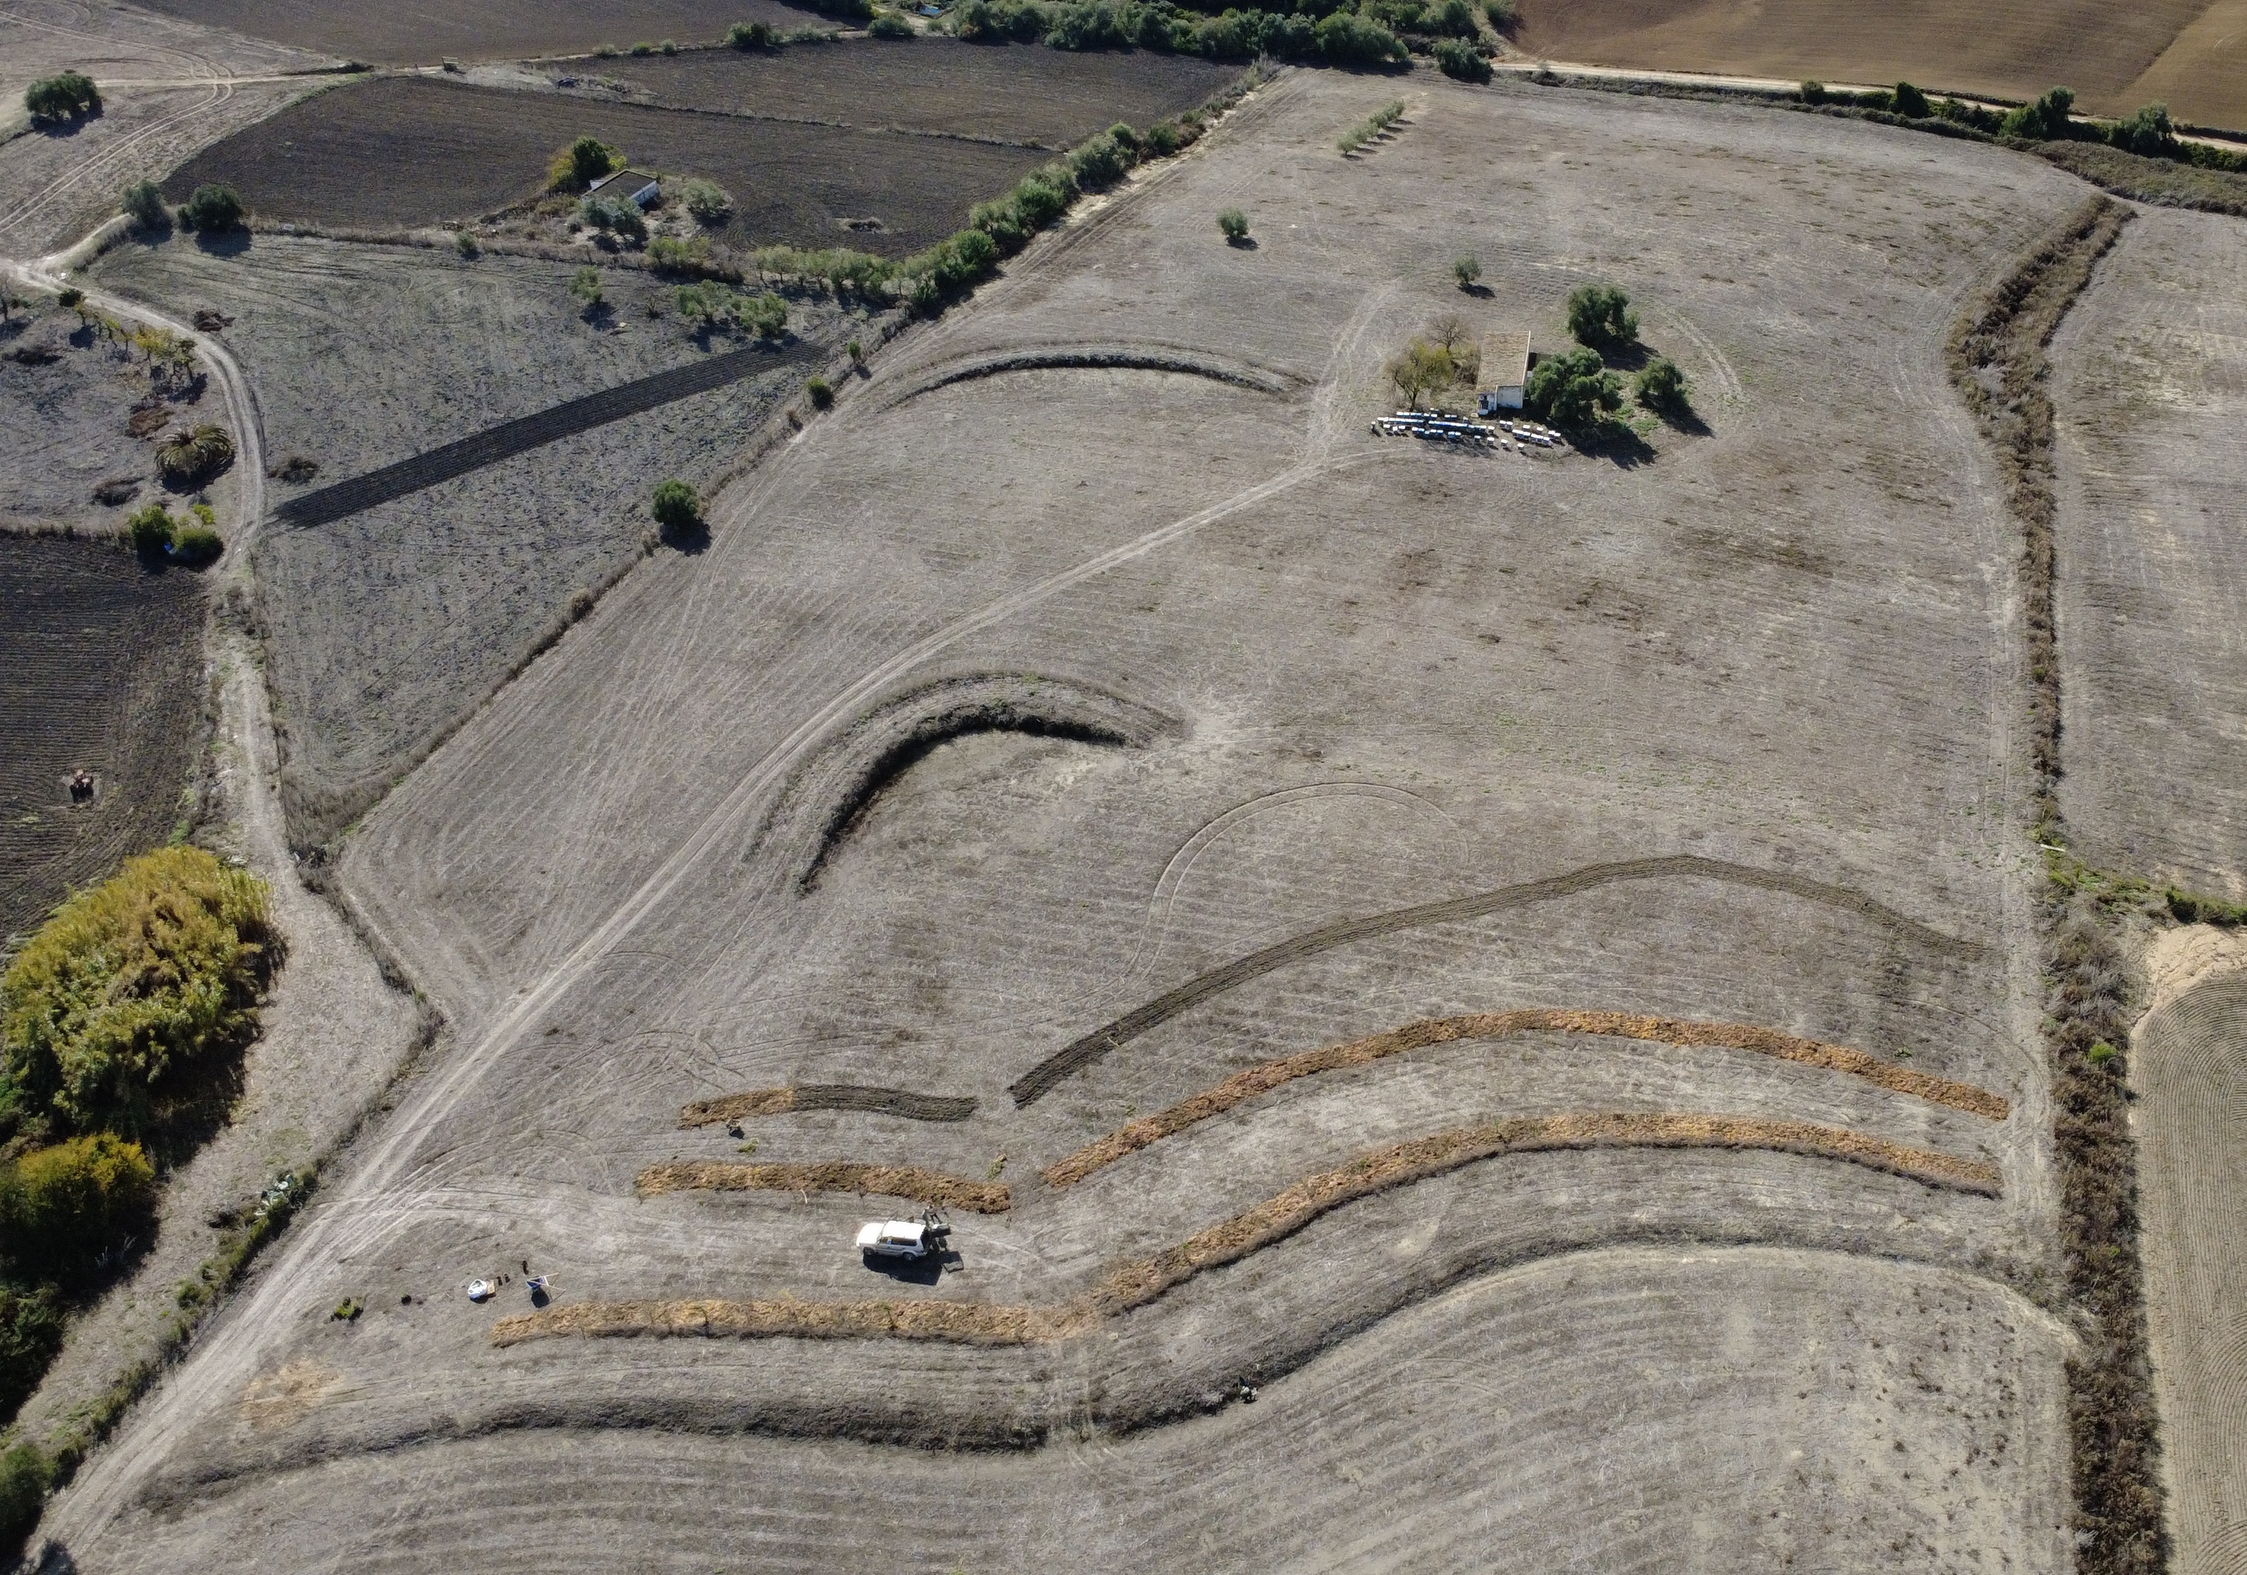
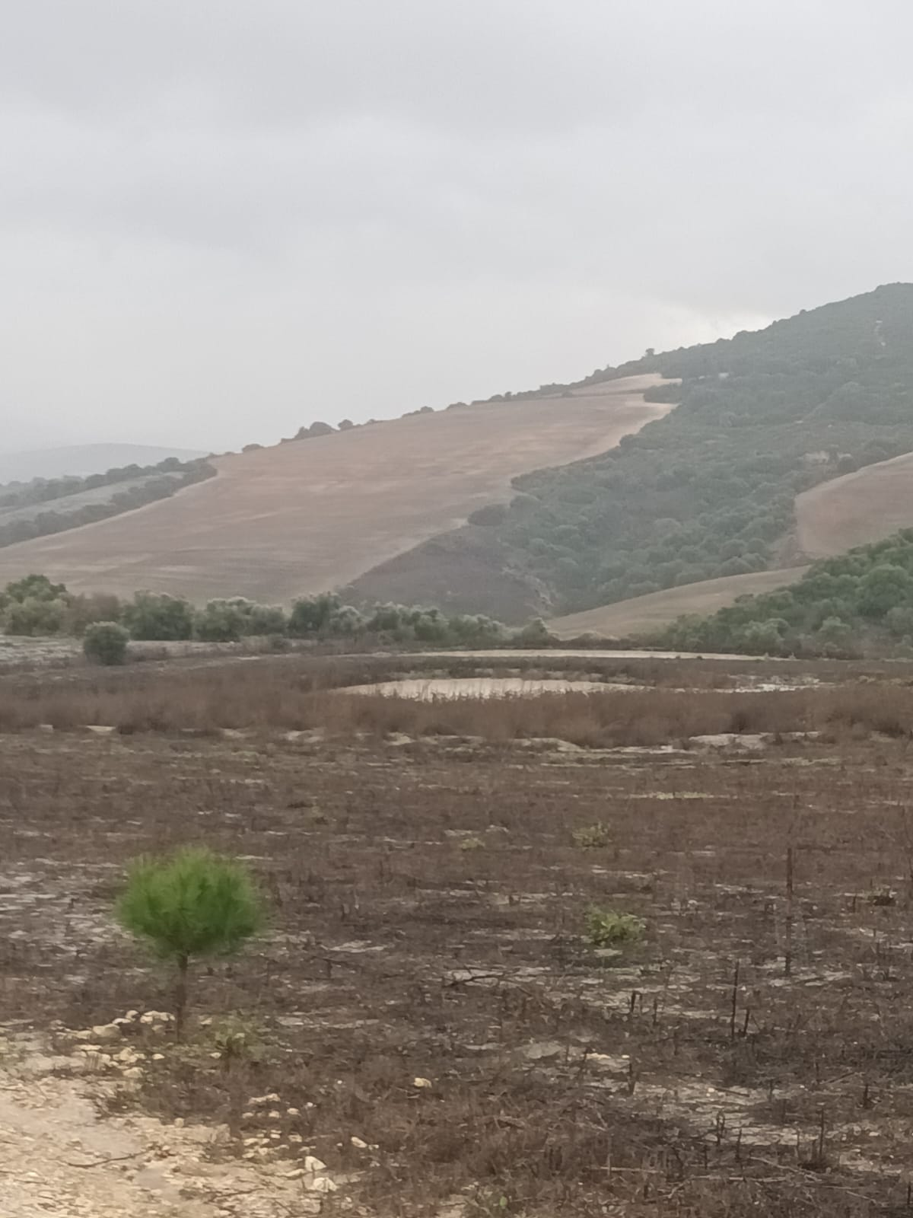
31 October 2024
GreenRock’s Character
5 February 2024
9 February 2024
Low-Input, High-Output Approach
Unique Non-Profit Approach
Pilot Results
Pilot Results
Scientific Argumentation
Scientific Argumentation
6 December 2025
31 October 2024
Expert Actor Support
Expert Actor Support
Non-Profit Network
Potential Contributor Network
Qualified Team
Qualified Team

Slide 10
What We Still Need
Establish Foundation
€ 2.500
Notary Costs
Shape Advisory Board
Non-Monetary
Expert Support
Knowledge Institution Partnerships
Non-Monetary
Soil Analysis Support
Biodiversity Survey Support
Government Subsidy Network
Non-Monetary
Geo-Spatial Modelling Equipment (LiDAR Drone)
€ 19.500
Zenmuse L2 €11.000
Biodiversity Survey Support €10.000
Website Complete
€ 3.000
Total Grant Expenditures
€ 25.000
+

Slide 11
Thank You
www.GreenRock.earth

